Slide 1
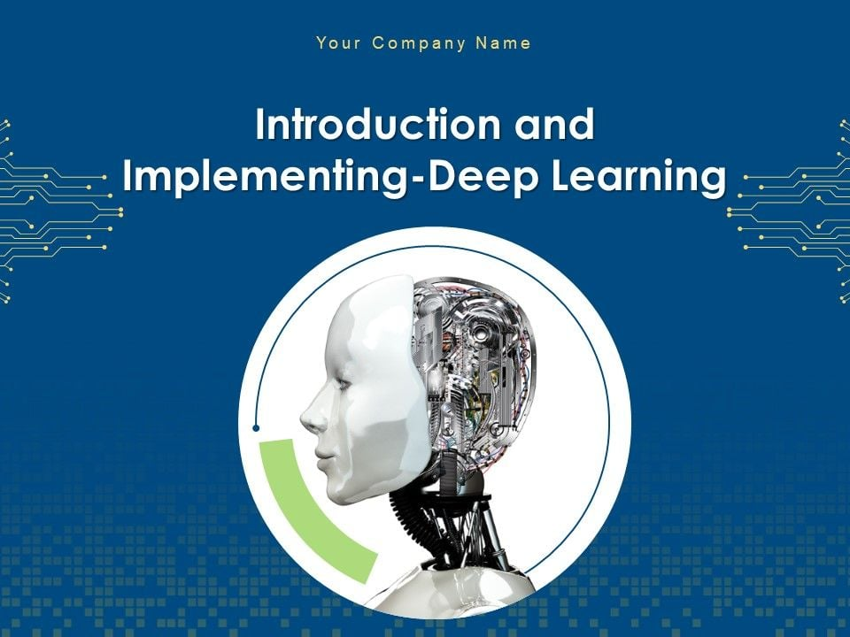

Slide 2
Topics to be Covered
Introduction: Difference Between ML, DL & Ai
Applications of AI
Conventional AI vs GenAI
Future of AI
Why DL use over ML (Machine Learning vs Deep Learning)
Deep Learning
Introduction to Deep Learning
Perceptron Model
Introduction to Tensorflow and Keras
Introduction to Types of Neural Networks
Deep and Shallow Neural Network
Artificial Neural Network Deep Dive
Activation Functions in NN
Loss Functions
Optimization Technique
Regularization Techniques
CallBacks

Slide 3
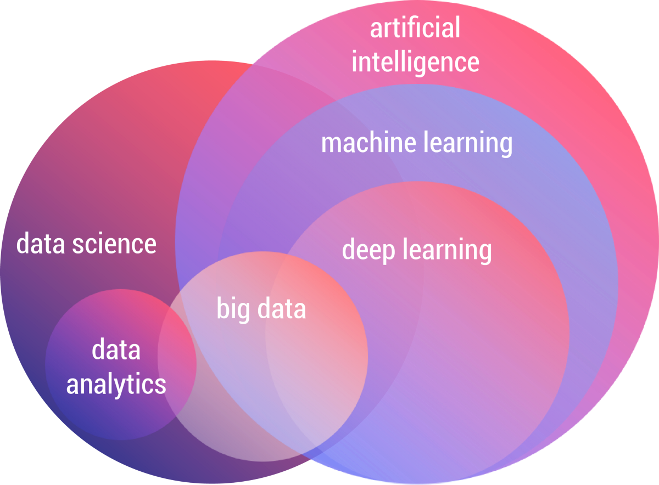

Slide 4
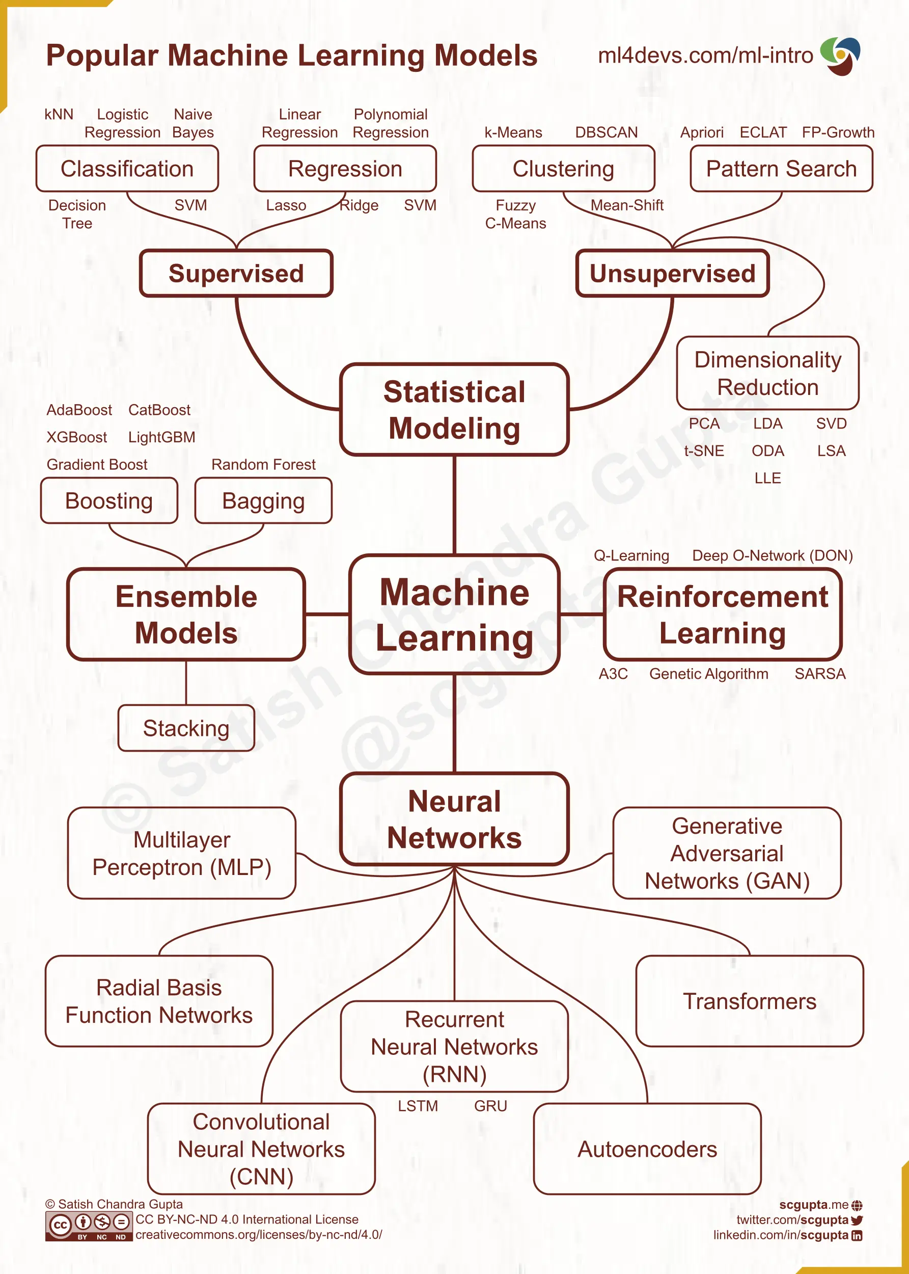
https://pythonnumericalmethods.studentorg.berkeley.edu/notebooks/chapter25.01-Concept-of-Machine-Learning.html

Slide 5
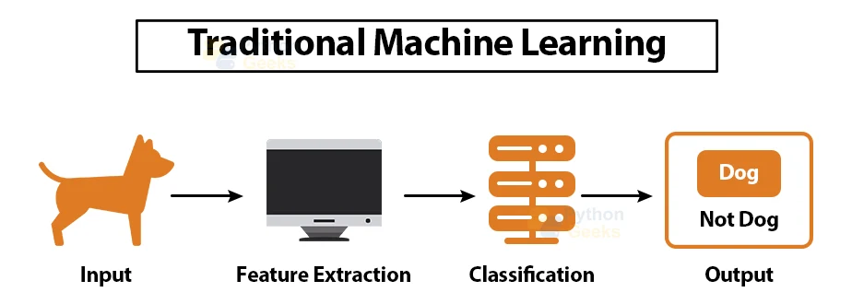
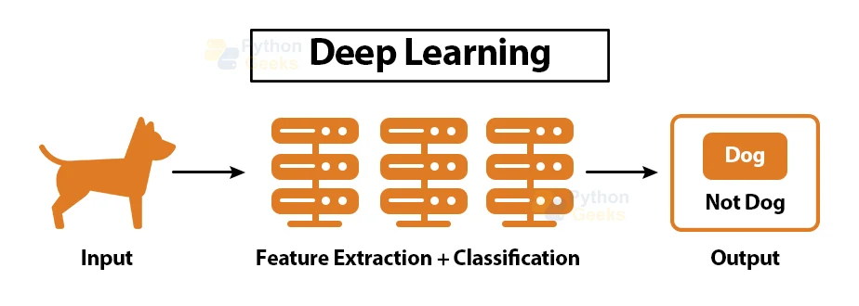

Slide 6
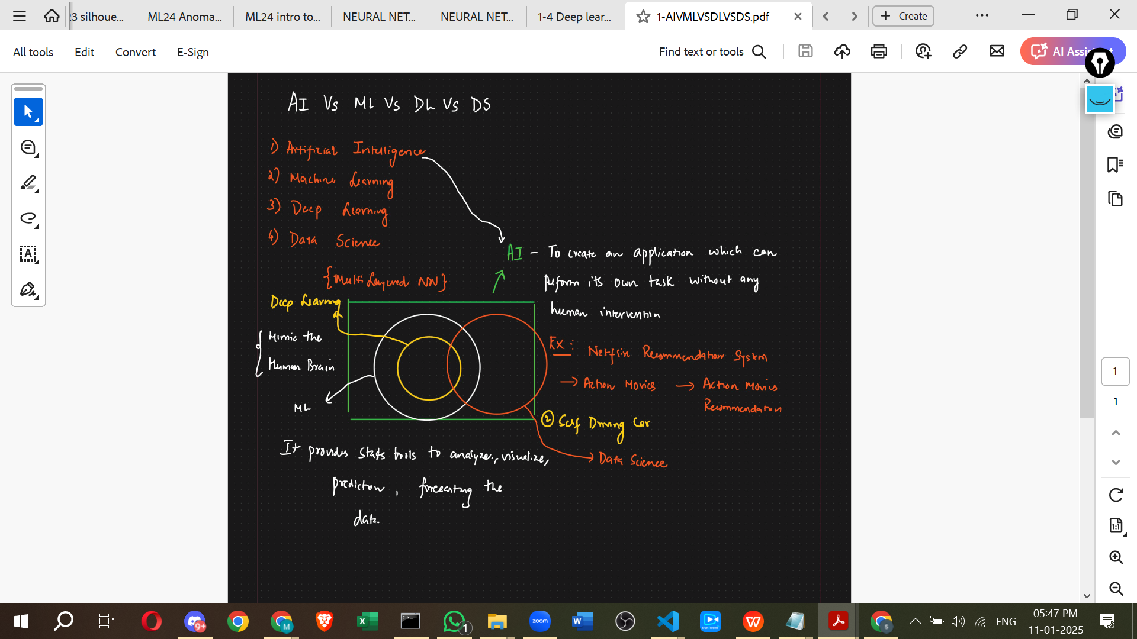

Slide 7
Artificial Intelligence (AI) refers to the simulation of human intelligence in machines that are designed to think, learn, and make decisions. AI encompasses a wide range of technologies, including rule-based systems, expert systems, and machine learning algorithms.
Key Features of AI:
Automation of tasks that require human intelligence.
Ability to learn from data and improve over time.
Applications across various domains, including healthcare, finance, and robotics.

Slide 8
Conventional AI vs Generative AI (GenAI)
Conventional AI:
Focuses on classification, prediction, and rule-based decision-making.
Uses structured datasets for training.
Examples: Spam filters, customer service chatbots, recommendation engines.
Generative AI (GenAI):
A type of AI that creates new content, such as text, images, and music.
Uses models like GANs (Generative Adversarial Networks) and transformers (e.g., GPT, DALL-E).
Examples: AI-generated art, chat-based content generation, and text-to-image synthesis.
Future of AI
The future of AI is expected to bring significant advancements and challenges:
AI-Augmented Creativity: More sophisticated generative models for content creation.
Explainable AI (XAI): Enhancing transparency and trust in AI decision-making.
Ethical AI Development: Addressing biases, privacy concerns, and responsible AI use.
AI in Edge Computing: Deployment of AI models on edge devices for real-time processing.
Superintelligence and AGI: Theoretical advancements toward artificial general intelligence (AGI) with human-like reasoning capabilities.
AI continues to evolve, driving innovation and transforming industries worldwide.

Slide 9
Introduction to Deep Learning
Deep Learning (DL) is a subset of Machine Learning that utilizes artificial neural networks with multiple layers to learn complex patterns in data. It enables high-level feature extraction from raw data and is the foundation for many modern AI applications.
Key Aspects of Deep Learning:
Multi-layered neural networks (deep networks) that extract hierarchical features.
Requires large datasets and significant computational power (e.g., GPUs, TPUs).
Performs exceptionally well in tasks like image recognition, natural language processing, and speech synthesis.

Slide 10
Very Brief History Of Deep Learning
1960s: Neural Networks used of binary classification
1970s: Neural Networks popularity dries after not delivering on the hype
1980s: Backpropagation is used to train the deep networks
1990s: Neural Networks take the back seat to support vector machines due to the nice theoretical properties and guarantee bounds
2010s: Access to large dataset and more computation allowed deep networks to return and have state-of-the-art results in the speech, vision and natural language processing.

Slide 11
Why Now?
Larger Datasets
Image 1000kb/ picture
Audio: 5000km/ song
Better Hardware
Transistors density doubles every 18months.
Cost per GB in 1995: $1000.00
Smarter Algorithms
Advances in algorithm innovation, including neural network, leading to better accuracy in training models
Video: 5,000,000/movie
Cost per GB in 2017: $0.02

Slide 12
Definations of Deep learning
AI vs DL vs ML
usecase
AI is a broader term that describes the capability of the machine to learn and solve problems just like humans. In other words, AI refers to the replication of humans, how it thinks, works and functions.
There are two ways of incorporating intelligence in artificial things i.e., to achieve artificial intelligence. One is through machine learning and another is through deep learning. That means DL and ML are ways of achieving AI.
ML comprises algorithms for accomplishing different types of tasks such as classification, regression, or clustering. The accuracy of algorithms increases with an increase in data.
“Difference between the predicted and actual value is computed using loss-function or objective function. Therefore, defining the objective/loss function is the gist of ML model.”
This is one of the reasons for the misconception that ML and DL are the same. However, the DL model is based on artificial neural networks which have the capability of solving tasks which ML is unable to solve.

Slide 13
Advantages of DL over ML
1. Feature Extraction
Machine learning algorithms such as Naive Bayes, Logistic Regression, SVM, etc., are termed as “flat algorithms”. By flat, we mean, these algorithms require pre-processing phase (known as Feature Extraction which is quite complicated and computationally expensive) before been applied to data such as images, text, CSV. For instance, if we want to determine whether a particular image is of a cat or dog using the ML model. We have to manually extract features from the image such as size, color, shape, etc., and then give these features to the ML model to identify whether the image is of a dog or cat.
However, DL models do not any feature extraction pre-processing step and are capable of classifying data into different classes and categories themselves. That is, in the case of identification of cat or dog in the image, we do not need to extract features from the image and give it to the DL model. But, the image can be given as the direct input to the DL model whose job is then to classify it without human intervention.
Raw Data is given to DL model. Pre-processed data is given to ML model.

Slide 14
2. Big Data
With technology and the ever-increasing use of the web, it is estimated that every second 1.7MB of data is generated by every person on the planet Earth. Therefore, analyzing and learning from data is of utmost importance.
Deep Learning is seen as a rocket whose fuel is data.
The accuracy of ML models stops increasing with an increasing amount of data after a point while the accuracy of the DL model keeps on increasing with increasing data.
https://shahilansari.medium.com/machine-learning-vs-deep-learning-vs-artificial-intelligence-ml-vs-dl-vs-ai-3f95dfa7ef87

Slide 15
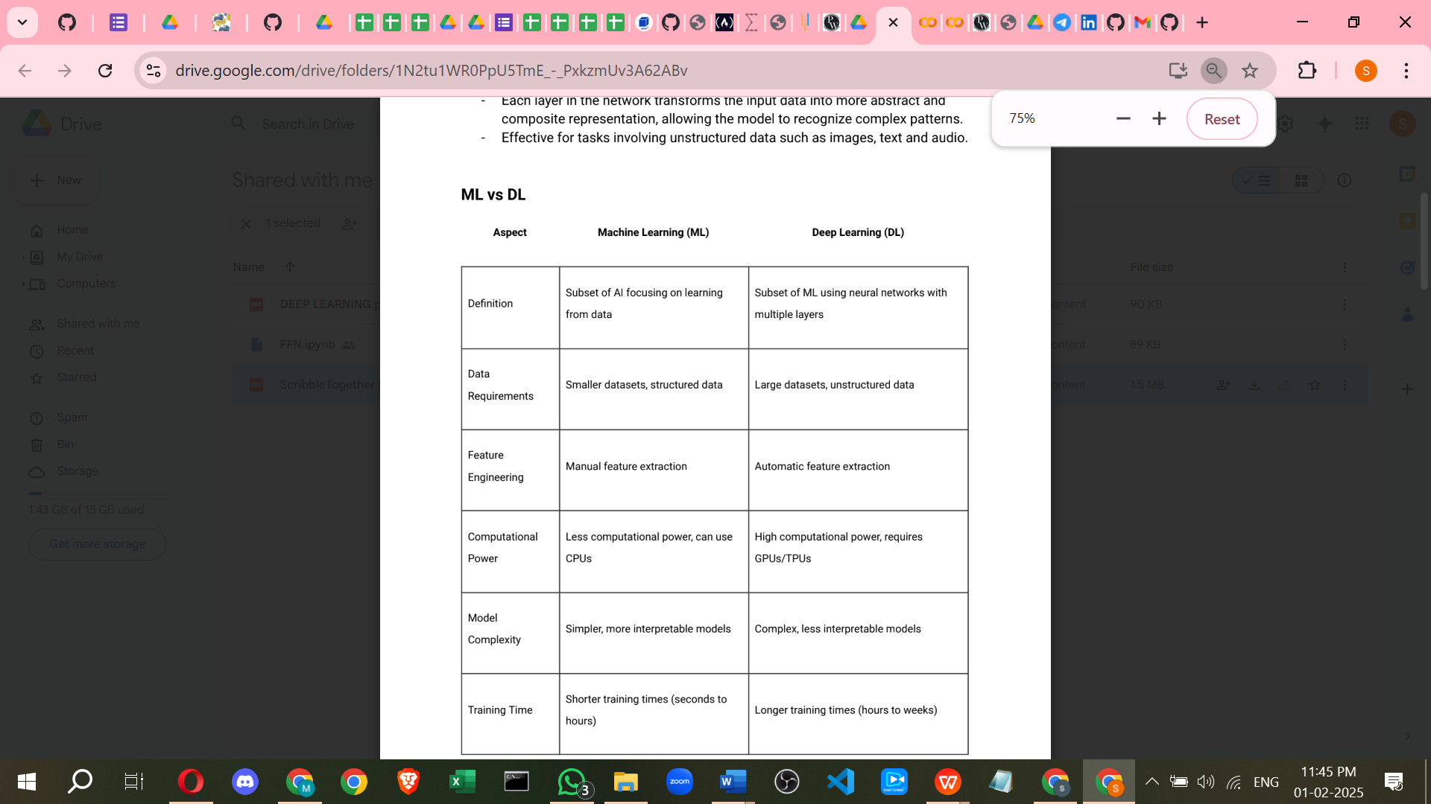

Slide 16
Deep Learning
Introduction to Deep Learning
Perceptron Model
Introduction to Tensorflow and Keras
Introduction to Types of Neural Networks
Deep and Shallow Neural Network
Artificial Neural Network Deep Dive
Activation Functions in NN
Loss Functions
Optimization Technique
Regularization Techniques
CallBacks

Slide 17
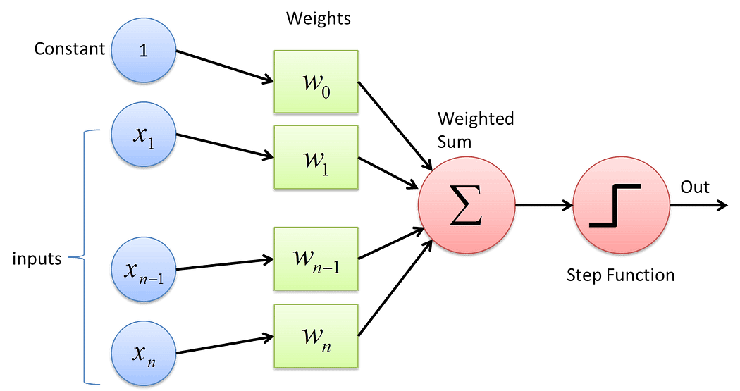
QUESTIONS MAKES
what is ai ml, dl
and where data analyst and data scientist stand
what is deep learning
Artificial neural network
why deep learning is so popular?
IN dl pass all types of data(image, video,audio,text)
NO feature engineering needed(automatic feacture extraction
scale of data DL accuracy improve but in ML not
DL is use in many domain
how DL works?
help of neural network.(what is NN) BIOLOGICAL NEURON:
https://drive.google.com/drive/folders/1N2tu1WR0PpU5TmE_-_PxkzmUv3A62ABv
basic unit of NN is Perceptron.(what is Perceptron) Simples ANN Architecture.
Framework --> keras, tensorflow, pytorch, mxnet etc
Preceptron Consists of :
i) 1 input layer
ii) 1 output layer (output node)
iii) No hidden layers
iv) Weights
v) Bias
vi) Summation Function
vii) Activation Function
https://medium.com/towards-data-science/what-the-hell-is-perceptron-626217814f53

Slide 18
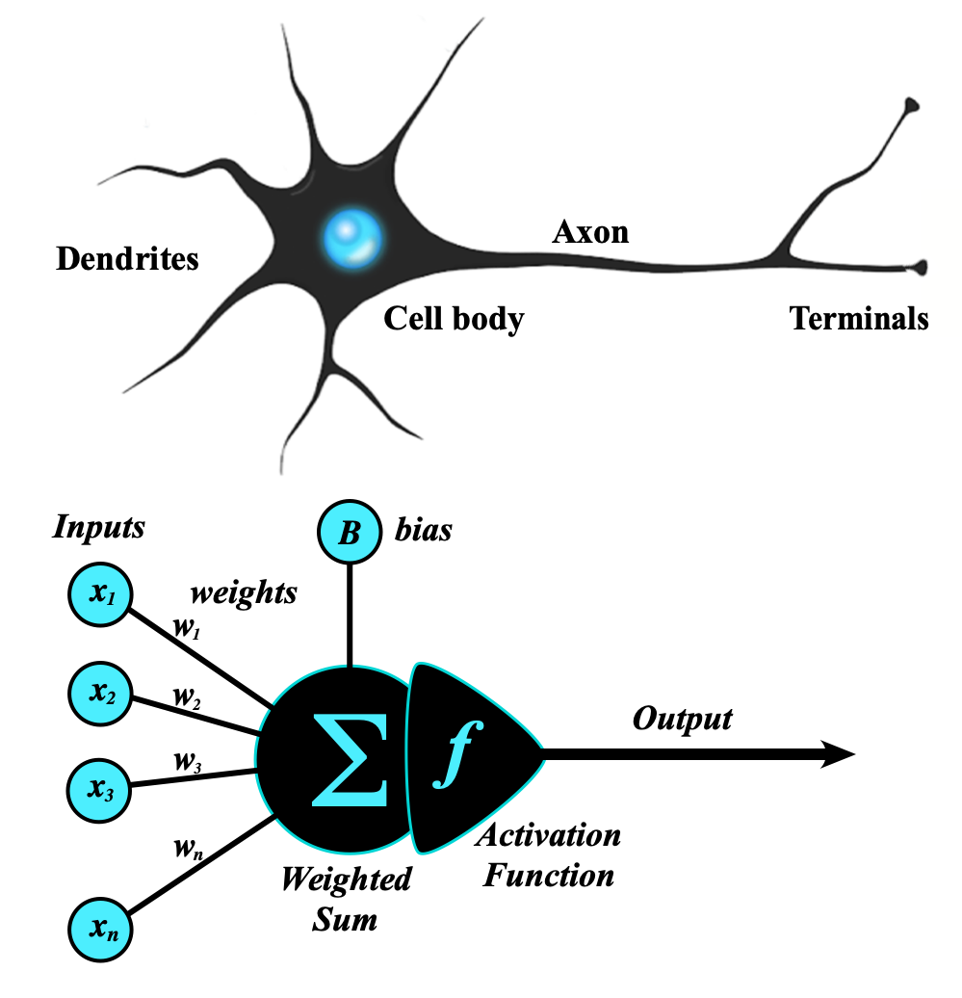
Perceptron Model
The perceptron is the simplest form of an artificial neural network and serves as the building block of more advanced models.
Components of a Perceptron:
Inputs: Feature values from the dataset.
Weights: Assigned to each input to signify importance.
Summation Function: Computes the weighted sum of inputs.
Activation Function: Applies a threshold to determine output.
Types of Perceptron Models:
Single-layer perceptron: Can only solve linearly separable problems.
Multi-layer perceptron (MLP): Can solve non-linear problems using multiple layers.
https://s.mriquestions.com/what-is-a-neural-network.html

